Slide 1
Genre Study Ongoing Literacy Training
A new perspective

Slide 2
Learning Targets: Genre Study
Learn about an inquiry process through the use of genre study.
Understand that this inquiry process can be applied to any genre study.
Create a working plan to think about incorporating the inquiry process in the study of genre.

Slide 3
Child’s Perspective
Interactive Read Aloud
Notes:
Do the read aloud of Cheyenne Again

Slide 4
Genre Study Components
Collect
Immerse
Study
Define
Teach
Read and Revise
Notes:
This needs to be on a chart, as well.
Genre study is an inquiry process and these are all the components.
We want you to be able to leave here today with new understandings, ready to try these components.

Slide 5
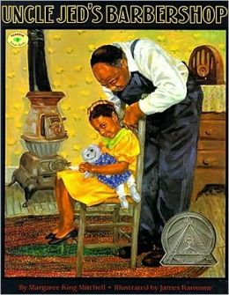
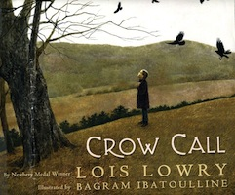
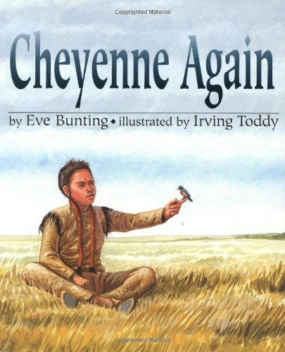
Collect and Immerse
Interactive Read Alouds
Book Talks
Guided Reading Books
Notes:
The first part of genre study is to collect books and immerse students through interactive read aloud. The immersion can also include book talks, a collection of books in the classroom for children to choose, and guided reading books. If you use in guided reading it should be because it fits what that group needs, not just because you’re studying this genre. If it fits great, but not every group needs to be reading these books.

Slide 6
Teacher’s Perspective

Slide 7
Genre Study:
A process of shared inquiry that helps students learn how to analyze the characteristics of a genre.
A process that helps students build a foundation of genre knowledge.
Read Chapter 2, pages 10-16
Notes:
Read Chapter 2, pages 10-16

Slide 8
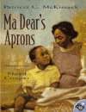
Study and Define
What do you notice?
How can we define?
Notes:
As you begin the genre study the focus is on minilesson on noticings and then each table writes a working definition on planning sheet.
Readers notice the characteristics of genre so they can understand what they are reading.
What do we notice about historical fiction:
Then we’d write a definition to incorporate the noticings.

Slide 9
What do we notice about historical fiction?

Slide 10
Food for thought…
If there is certainty or only one view, there is nothing to discuss and nothing to learn. Uncertainty is the foundation of inquiry and research.
Peter Johnston, Genre Study, p.2

Slide 11
Teach, Read and Revise
What more do they need to learn about the genre?
Notes:
This is where you’d do the direct teaching to clear up any misconceptions or missed characteristics. It’s also a place to teach the importance of some characteristics.
Readers notice the importance of the setting in historical fiction so that they can understand what it would have been like for the characters to live at that time.

Slide 12
Readers notice the importance of the setting in historical fiction so that they can understand what it would have been like for the characters to live at that time.

Slide 13
A long time ago when there was no electricity and the streetlamps in Little Italy had to be lit by hand. Peppe lived in a tenement on Mulberry Street.

Slide 14
We came Nebraska Territory in the spring. Our oxen, Brownie and Blackie, pulled the wagon and our cow, Moo, was tied on behind. It was a long way from my grandparents’ home in Illinois. A long, long way.

Slide 15
Long, long time ago in China in the mid 1800s – there was a rebellion against the government by the people.
Two brothers bowed goodbye to their family and boarded the overcrowded ship with hundreds of others frantic for work.
After almost two months on the stormy seas, they finally arrived in San Francisco.

Slide 16
In Groups of 3
Everyone should read All read 239-242
Group 1: Read 242-up to Genre study 249.
Group 2: Read 249 (genre study)- 269
Group 3: Read270-284
Notes:
Chapter 15. Split into groups of 3 (count off) All read 239-242. 1: 242-up to Genre study 249. 2: 249 (genre study- 269) 3: 270-284. As we inquire we refine our teaching and the direct instruction is based on the observations and direct response to what the students are demonstrating. We have an active role, not a passive role. The role then of GR and Lit Study becomes targeted instruction for small groups that are missing key elements the rest of the class has under control. Targeted groups based on the genre elements vs text level

Slide 17
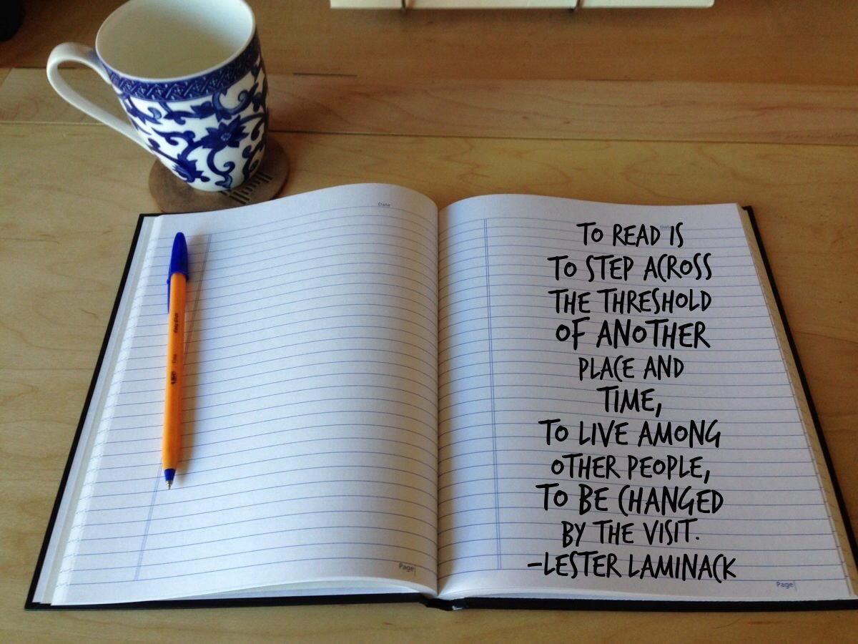
Notes:
This is the real construction that children will do as they study genre. They will be changed and understand more deeply, and you will too.

Slide 18
Get into grade level groups
What are you thinking about Genre Study now?
What genre might we try this with?

Slide 19
Genre Study Components
Collect
Immerse
Study
Define
Teach
Read and Revise
Notes:
This needs to be on a chart, as well.
Watch the 6 minute movie on inquiry based teaching.
Start the session with Interactive Read Aloud : Cheyenne Again, stopping for within, beyond and about thinking questions

Slide 20
Grade Level Groups
How can we incorporate inquiry?
What are you thinking about genre study now?
What genre could we try next?
Notes:
In grade level groups, start thinking of the next steps you could try…

